Slide 1
Summary of BP Prediction Experiments

Slide 2
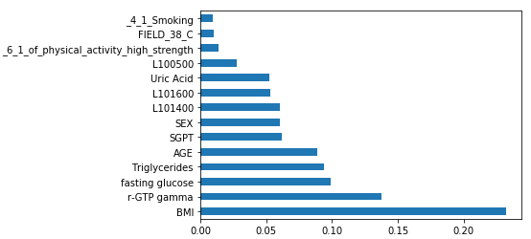
1. Hypertension classification
Features
BMI
r-GTP gamma
fasting glucose
Triglycerides
AGE
SGPT
SEX
L101400 – LDH, legacy dehydratase
Uric Acid
L101600 - Alkaline phosphatase
L100500 - Creatinine
6_1_of_physical_activity_high_strength _
4_1_Smoking
FIELD_38_C - Drinking_5_1_days

Slide 3
1. Hypertension classification
Class boundaries
SBP >= 140 Or DBP >= 90 : Class=2
SBP < 120 And DBP <80 : Class=0
Otherwise Class = 1
Total class distribution:
Class 2: 14,170
Class 1: 14,015
Class 0: 14,231

Slide 4
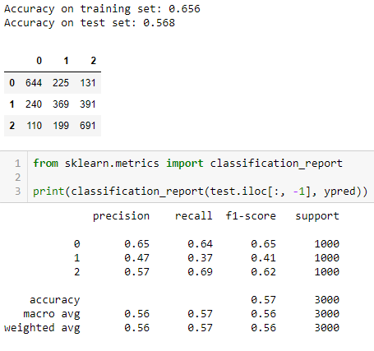
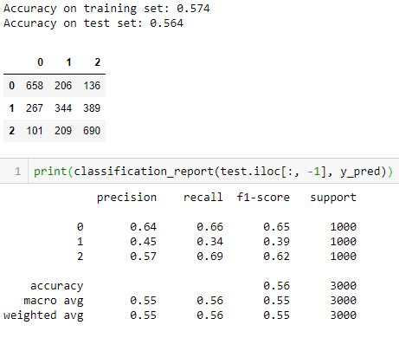
1. Hypertension classification
Random Forest Classifier
XGB Classifier

Slide 5
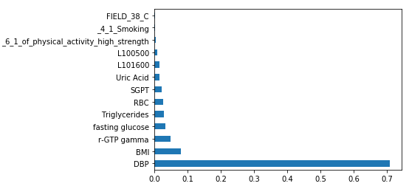
2. SBP – Classification, with DBP
Features
DBP
BMI
RBC
Uric Acid
Triglycerides
fasting glucose
L100500 - Creatinine
r-GTP gamma
SGPT
L101600 - Alkaline phosphatase
4_1_Smoking
FIELD_38_C - Drinking_5_1_days
6_1_of_physical_activity_high_strength
 | Training size
CLASS 2 | 15,939
CLASS 1 | 15,939
CLASS 0 | 15,939

Slide 6
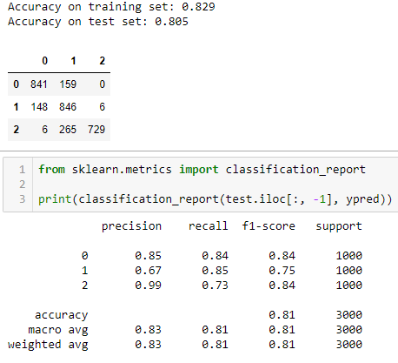
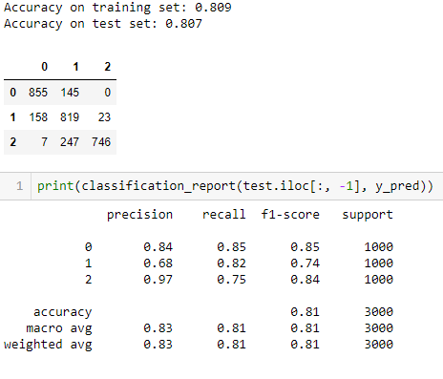
2. SBP – Classification, with DBP
Random Forest Classifier
XGB Classifier

Slide 7
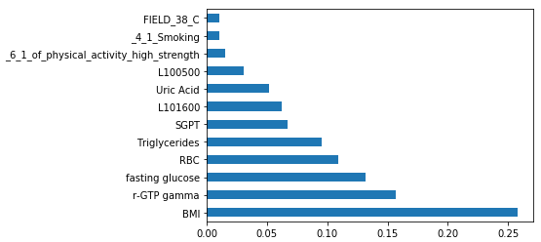
3. SBP – Classification, with out DBP
Features
BMI
RBC
Uric Acid
Triglycerides
Fasting glucose
L100500 - Creatinine
r-GTP gamma
SGPT
L101600 - Alkaline phosphatase
4_1_Smoking
FIELD_38_C - Drinking_5_1_days
6_1_of_physical_activity_high_strength
 | Training size
CLASS 2 | 15,939
CLASS 1 | 15,939
CLASS 0 | 15,939

Slide 8
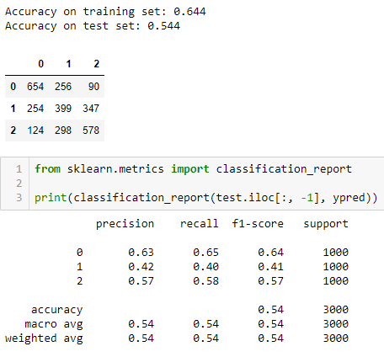
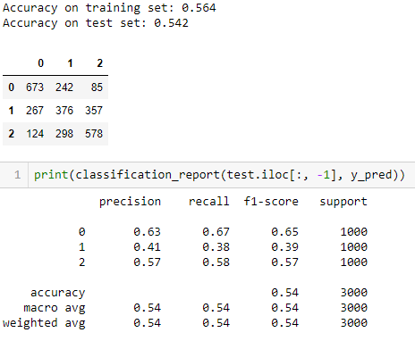
3. SBP – Classification, with out DBP
Random Forest Classifier
XGB Classifier

Slide 9
4. SBP – Regression with out DBP
Features
L190300 - RBC
FIELD_29 - family history (hypertension)
S000300 - BMI
FIELD_38 - Drinking 5-1 days (1 week)
AGE
SEX
L100700 - Uric acid
L100800 - Fasting glucose
FIELD_33 - 4-1 Smoking
FIELD_41 - 6-2 of physical activity (moderate)
FIELD_42 - 6-3 of physical activity (walking)
L190500 - HCT
L101600 - alkaline phosphatase
L103100 - HDL-Cholesterol
L103000 - Triglyceride
Training size | 282,316
Testing size | 120,993

Slide 10
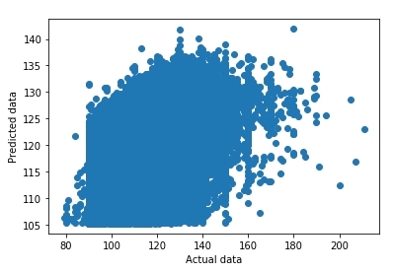
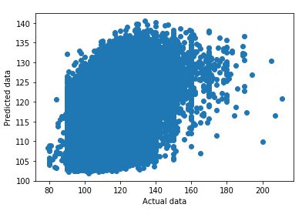
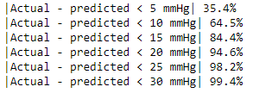
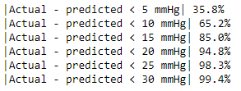
4. SBP – Regression with out DBP
Random Forest Regressor
R² score 0.298
XGB Regressor
R² score 0.315

Slide 11
5. SBP – Regression with DBP
Features
L190300 - RBC
FIELD_29 - family history (hypertension)
S000300 - BMI
FIELD_38 - Drinking 5-1 days (1 week)
AGE
SEX
L100700 - Uric acid
L100800 - Fasting glucose
FIELD_33 - 4-1 Smoking
FIELD_41 - 6-2 of physical activity (moderate)
FIELD_42 - 6-3 of physical activity (walking)
L190500 - HCT
L101600 - alkaline phosphatase
L103100 - HDL-Cholesterol
L103000 - Triglyceride
DBP
Training size | 282,316
Testing size | 120,993

Slide 12
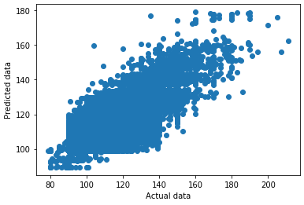
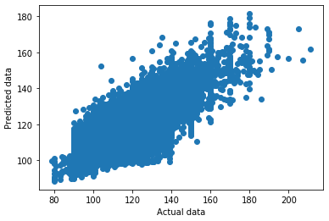
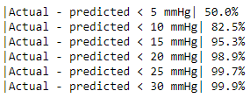
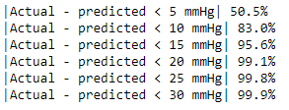
5. SBP – Regression with DBP
Random Forest Regressor
R² score 0.652
XGB Regressor
R² score 0.661

Slide 13
6. SBP – Next year value prediction
Features
S000501 - SBP
S000300 - BMI
S000502 - DBP
L103000 - Triglyceride
L100800 - Fasting glucose
L103100 - HDL-Cholesterol
L100700 - Uric Acid
L101300 - SGPT
L190500 - HCT
L190300 - RBC
L103300 - Cardiac risk factor
L190400 - Hemoglobin
L101700 - r-GTP gamma
L101600 - alkaline phosphatase
Training size | 102,533
Testing size | 25,634

Slide 14
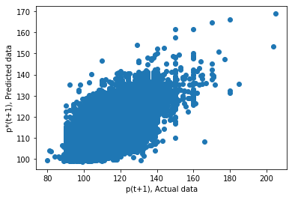
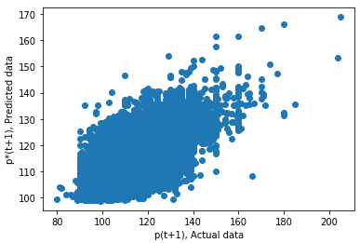
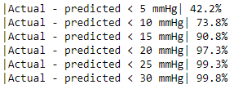
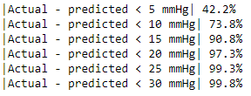
6. SBP – Next year value prediction
Random Forest Regressor
R² score 0.488
XGB Regressor
R² score 0.493

Slide 15
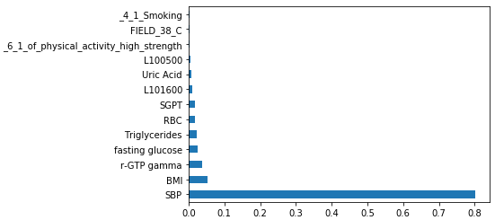
7. DBP – Classification with SBP
Features
SBP
BMI
RBC
Uric Acid
Triglycerides
fasting glucose
L100500 - Creatinine
r-GTP gamma
SGPT
L101600 - alkaline phosphatase
4_1_Smoking
FIELD_38_C - Drinking_5_1_days
6_1_of_physical_activity_high_strength
 | Training size
CLASS 2 | 15,939
CLASS 1 | 15,939
CLASS 0 | 15,939

Slide 16
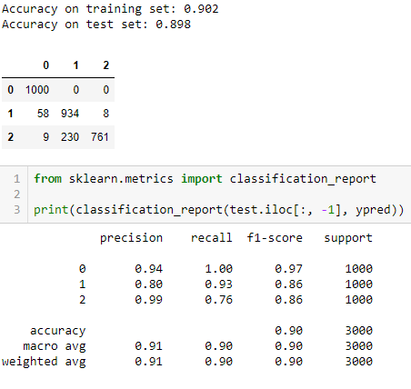
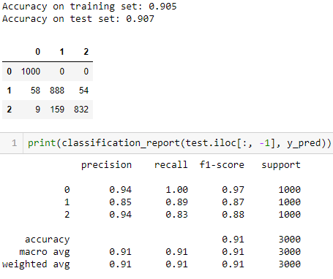
7. DBP – Classification with SBP
Random Forest Classifier
XGB Classifier

Slide 17
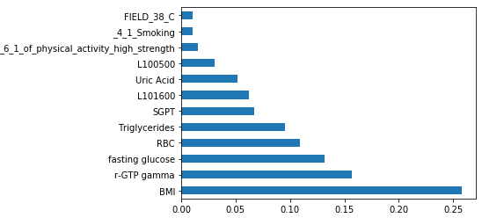
8. DBP – Classification with out SBP
Features
BMI
RBC
Uric Acid
Triglycerides
fasting glucose
L100500 - Creatinine
r-GTP gamma
SGPT
L101600 - alkaline phosphatase
4_1_Smoking
FIELD_38_C - Drinking_5_1_days
6_1_of_physical_activity_high_strength
 | Training size
CLASS 2 | 15,939
CLASS 1 | 15,939
CLASS 0 | 15,939

Slide 18
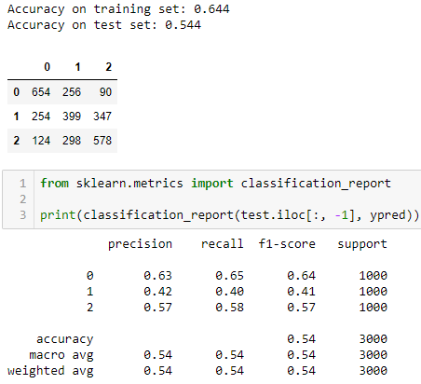
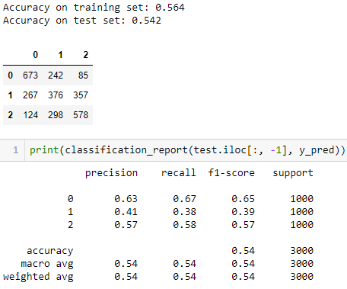
8. DBP – Classification with out SBP
Random Forest Classifier
XGB Classifier

Slide 19
9. DBP – Regression with out SBP
Features
L190300 - RBC
S000300 - BMI
FIELD_38 - Drinking 5-1 days (1 week)
AGE
L100700 - Uric Acid
L100800 - fasting glucose
FIELD_33 - 4-1 Smoking
FIELD_41 - 6-2 of physical activity (moderate)
FIELD_42 - 6-3 of physical activity (walking)
L190500 - HCT
L101600 - alkaline phosphatase
L103100 - HDL-Cholesterol
L103000 - Triglycerides
Training size | 369,492
Testing size | 92,373

Slide 20
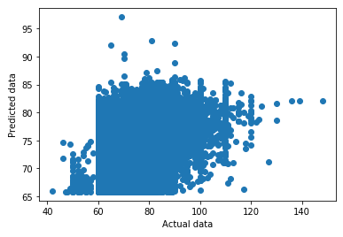
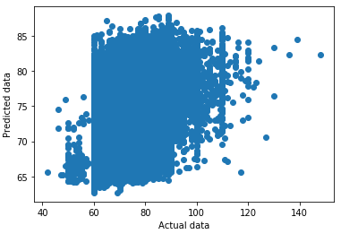
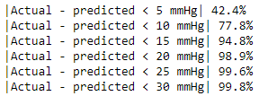
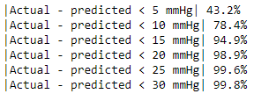
9. DBP – Regression with out SBP
Random Forest Regressor
R² score 0.220
XGB Regressor
R² score 0.235

Slide 21
10. DBP – Regression with SBP
Features
L190300 - RBC
S000300 - BMI
FIELD_38 - Drinking 5-1 days (1 week)
AGE
L100700 - Uric Acid
L100800 - fasting glucose
FIELD_33 - 4-1 Smoking
FIELD_41 - 6-2 of physical activity (moderate)
FIELD_42 - 6-3 of physical activity (walking)
L190500 - HCT
L101600 - alkaline phosphatase
L103100 - HDL-Cholesterol
L103000 – Triglycerides
SBP
Training size | 369,492
Testing size | 92,373

Slide 22
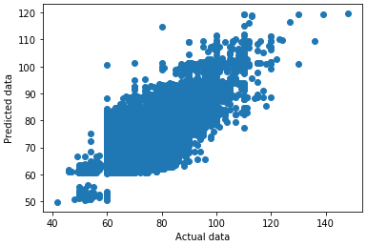
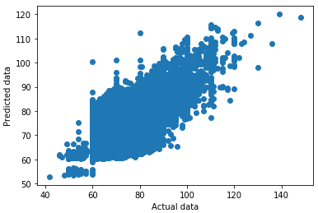
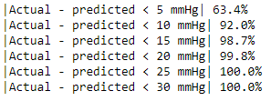
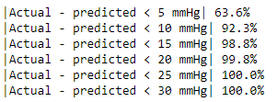
10. DBP – Regression with out SBP
Random Forest Regressor
R² score 0.616
XGB Regressor
R² score 0.622

Slide 23
11. DBP – Next year value prediction
Features
S000501 - SBP
S000502 - DBP
S000300 - BMI
L103000 - Triglycerides
L100700 - Uric Acid
L100800 - fasting glucose
L101300 - SGPT
AGE
L103100 - HDL-Cholesterol
L101700 - r-GTP gamma
L103300 - Cardiac risk factor
FIELD_42 - 6-3 of physical activity (walking)
L100500 - Creatinine
Training size | 103,057
Testing size | 25,765

Slide 24
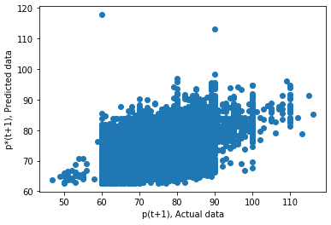
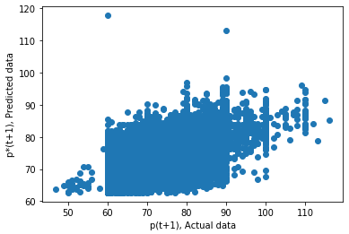
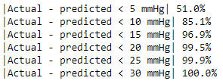
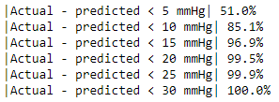
11. DBP – Next year value prediction
Random Forest Regressor
R² score 0.405
XGB Regressor
R² score 0.411

